Slide 1
HW Unit 4
Chenyuang Wang 15620161152281

Slide 2
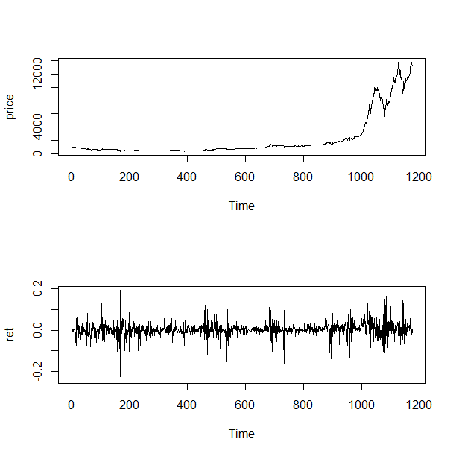
1. improve the R quantlets on GH (from CRIX directory on quantlet.de) and make
The daily value of indices in the CRIX and The log returns of CRIX index
library("rjson")
json_file = "http://crix.hu-berlin.de/data/crix.json"
json_data = fromJSON(file=json_file)
crix_data_frame = as.data.frame(json_data)
n<-dim(crix_data_frame)
a<-seq(1,n[2],2)
b<-seq(2,n[2],2)
date<-t(crix_data_frame[1,a])
price<-t(crix_data_frame[1,b])
ts.plot(price)
ret<-diff(log(price))
par(mfrow=c(2,1))
ts.plot(ret)

Slide 3
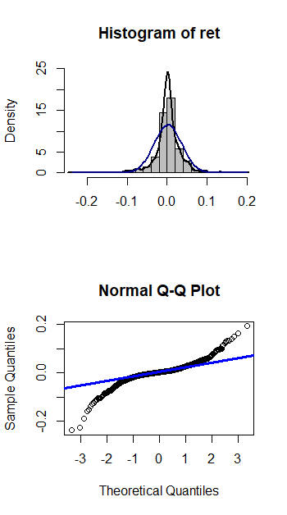
Histogram and QQ plot of CRIX returns
# histogram of returns
par(mfrow=c(2,1))
hist(ret, col = "grey", breaks = 20, freq = FALSE, ylim = c(0, 25), xlab = NA)
lines(density(ret), lwd = 2)
mu = mean(ret)
sigma = sd(ret)
x = seq(-4, 4, length = 100)
curve(dnorm(x, mean = mean(ret), sd = sd(ret)), add = TRUE, col = "darkblue", lwd = 2)
# qq-plot
qqnorm(ret)
qqline(ret, col = "blue", lwd = 3)

Slide 4
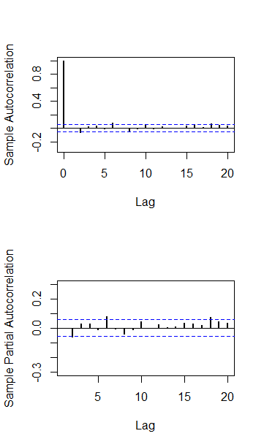
The sample ACF and PACF of CRIX returns
# acf plot
autocorr = acf(ret, lag.max = 20, ylab = "Sample Autocorrelation", main = NA,lwd = 2, ylim = c(-0.3, 1))
# plot of pacf
autopcorr = pacf(ret, lag.max = 20, ylab = "Sample Partial Autocorrelation", main = NA, ylim = c(-0.3, 0.3), lwd = 2)

Slide 5
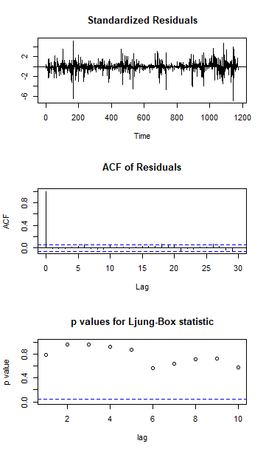
Diagnostic Checking
fit202 = arima(ret, order = c(2, 0, 2))
tsdiag(fit202)

Slide 6
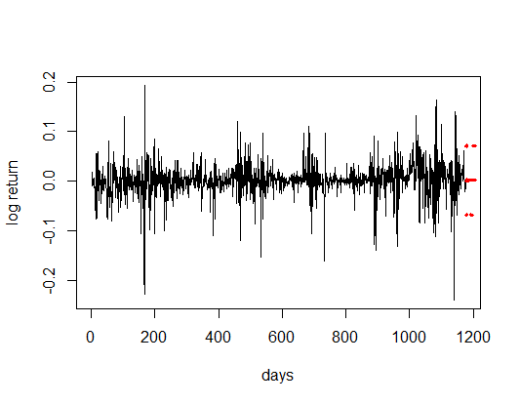
CRIX returns and predicted values
# arima202 predict
fit202 = arima(ret, order = c(2, 0, 2))
crpre = predict(fit202, n.ahead = 30)
plot(ret, type = "l", ylab = "log return",xlab = "days",lwd = 1.5)
lines(crpre$pred, col = "red", lwd = 3)
lines(crpre$pred + 2 * crpre$se, col = "red", lty = 3, lwd = 3)
lines(crpre$pred - 2 * crpre$se, col = "red", lty = 3, lwd = 3)
The confidence bands are red dashed lines.

Slide 7
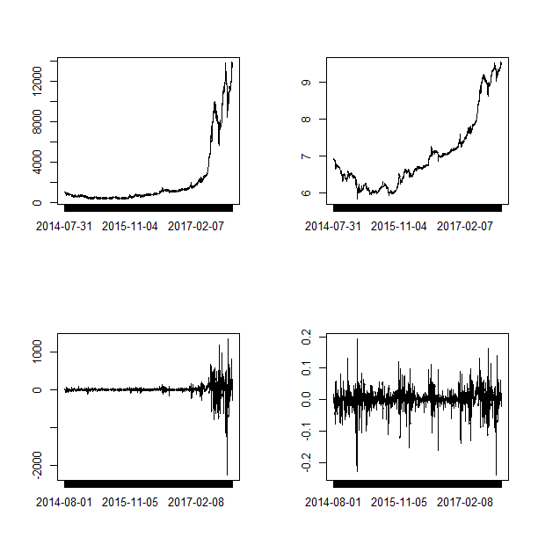
comparison of different crix returns
crx = data.frame(date, price)
retts = data.frame(date[-1], ret)
names(retts)=c("Dare","ret")
names(crx)=c("Da","Pr")
# comparison of different crix returns
par(mfrow = c(2, 2))
plot(crx$Da, crx$Pr, type = "o")
lines(crx$Pr)
plot(crx$Da, log(crx$Pr), type = "o")
lines(log(crx$Pr))
plot(retts$Dare, diff(crx$Pr), type = "o")
lines(diff(crx$Pr))
plot(retts$Dare, retts$ret, type = "o")
lines(retts$ret)

Slide 8
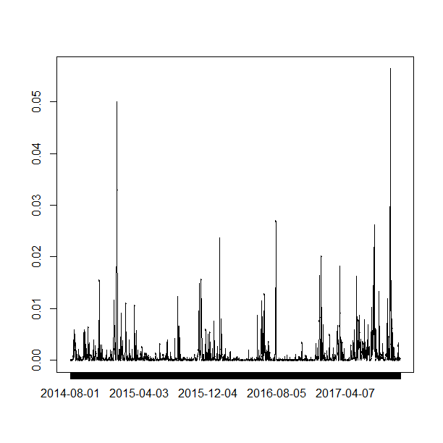
vola cluster
# vola cluster
par(mfrow = c(1, 1))
res = fit202$residuals
res2 = fit202$residuals^2
tsres202 = data.frame(date[-1], res2)
names(tsres202)=c("Dare","res2")
plot(tsres202$Dare, tsres202$res2, type = "o",
ylab = NA)
lines(tsres202$res2)

Slide 9
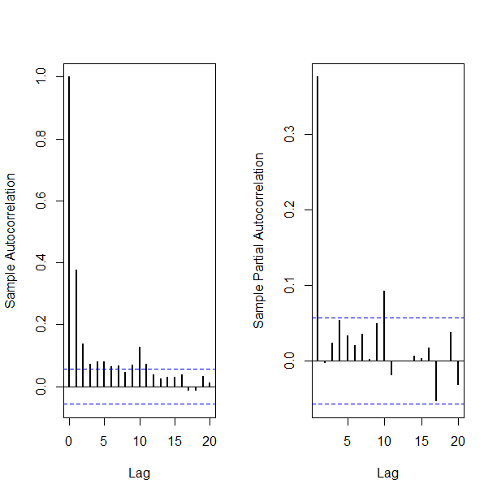
par(mfrow = c(1, 2))
#plot(res2, ylab='Squared residuals', main=NA)
acfres2 = acf(res2, main = NA, lag.max = 20, ylab = "Sample Autocorrelation",lwd = 2)
pacfres2 = pacf(res2, lag.max = 20, ylab = "Sample Partial Autocorrelation", lwd = 2, main = NA)

